Slide 1
Network Security Management
Overview

Slide 2

What Is Network Security
Protection of Integrity, Availability & Confidentiality of Network Assets and Services from associated Threats and Vulnerabilities

Slide 3
Why Network Security
Business Requirement
  to avoid financial loss
  to avoid loosing market share (Sales. Revenue)
  to avoid loss of Productivity or Processing Capability
  to maintain availability of Services (information, communication)
  to avoid damage to image (Brand, Reputation)

Slide 4
Why Network Security
Legal Requirement
  to protect personnel and customer data (Data Protection Act)
  to protect Intellectual Property Right

Slide 5

Cost of Security
Increased security increases the cost of the system.
The cost of security is a combination of many factors
  Cost for decreased system performance
  Cost for increased system complexity
  Cost for decreased system usability
  Increased operation and maintenance cost

Slide 6
Security Vs Convenience...
Security: The maximum security can be achieved by either turning off or giving no access to the Network
Convenience: The maximum convenience is to put no restriction in accessing the network resources and services

Slide 7

Security Vs Convenience...
To make the decisions concerning the security of computer networks involve a tradeoff between security and convenience
More security measures may lead to inconvenience and complaints from users

Slide 8
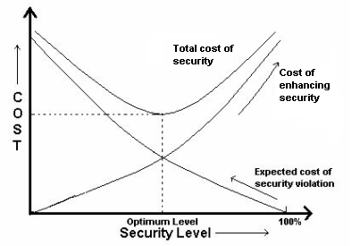
Security Vs Convenience

Slide 9

Difficulty in Securing Network...
Securing network is more difficult than a standalone computer because of its
  Connectivity
  Complexity

Slide 10
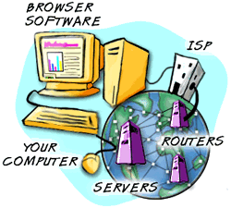
Difficulty in Securing Network...
Connectivity
  More people are connected
  Sometimes outsiders through Internet or Extranet
  One attacker in one computer may pose potential threat to all the connected computers
  Difficult to enforce discipline among users

Slide 11
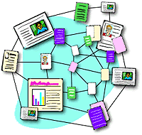
Difficulty in Securing Network
Complexity
  Difficult to keep track of changes
  Multiple OS
  Difficult to enforce technical security measures

Slide 12
How to Manage Network Security
Define and document security policy
Undertake risk assessment
Select suitable security controls/safeguards to bring down the risks to acceptable level
Implement the controls
Regularly monitor the effectiveness of the controls by suitable means

Slide 13

Why Security Policy
“The best security technology with a bad policy may look like a grass hut with a steel gate.”

Slide 14

What is Security Policy
Rules, directives and practices that govern how assets, including sensitive information, are managed, protected and distributed within an organization

Slide 15
Establishing Security Policy
Define and document a security policy that defines the limits of acceptable behaviour and how the organization will respond to violations of such behaviour
It differs from organization to organization , based on unique needs
The policy should be concise, to the point, easy to understand and widely publicized
The rationale for the policy should be stated clearly… why data integrity, confidentiality and availability is important

Slide 16
Establishing Security Policy
Security must be everyone’s responsibility hence the security policy should encompass the whole organization and its subsidiaries
As security is as strong as its weakest link, everyone in the organization must be held to the same set of standards
The policy should ensure compliance with all laws
The policy should be reviewed periodically to respond to changes in technology or circumstances

Slide 17
Questions to Be Addressed
If a security breach is in progress, who and how should be notified
What audit trail and log files must be maintained
How will the affected network portions to be identified and isolated
How will violators be punished
When will law enforcement authorities be notified
How will the organization recover from a security breach

Slide 18
Policy Example
No playing of computer games on corporate computers
No visiting of indecent / non-productive web sites using corporate network
Prohibition against taking copies of certain corporate electronic documents out of office
No use of pirated software
Do not use corporate e-mail account for sending personal e-mail

Slide 19

What is Asset
An asset is something to which an organization assigns value and hence for which it requires protection

Slide 20
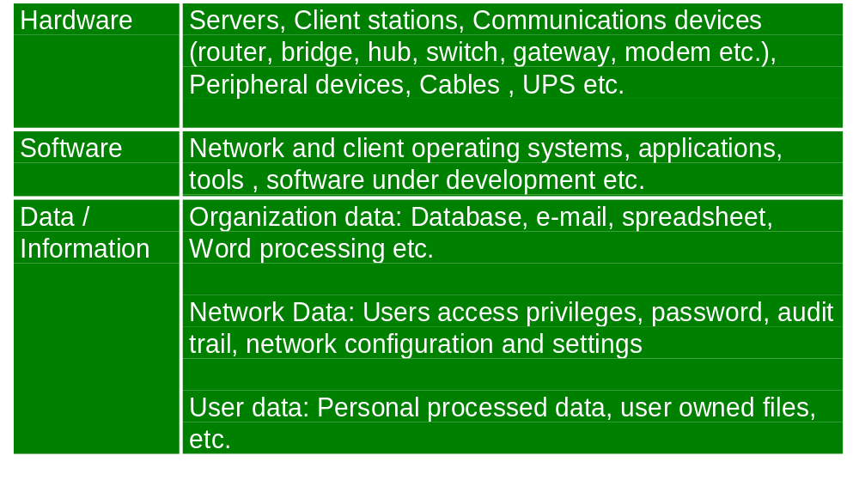
Network Assets

Slide 21

What is Threat
Threat is anything that could cause damage / harm / loss to assets
Threat would need to exploit vulnerability of the assets
Threat can be accidental or deliberate

Slide 22
Threats
Damage to communication lines/cables
Deterioration of storage media
Evesdropping
Hardware failure
Maintenance error
Malicious software
Misuse of resources
Unauthorized network access
Administrator error
User error
Traffic overloading
Transmission error

Slide 23
Threats
Theft
Fire
Flood
Lightning
Earthquake
Power fluctuation
Extreme temperature and humidity
Staff shortage
Misrouting or rerouting of messages
Use of network facilities in an unauthorised way
Software failure

Slide 24
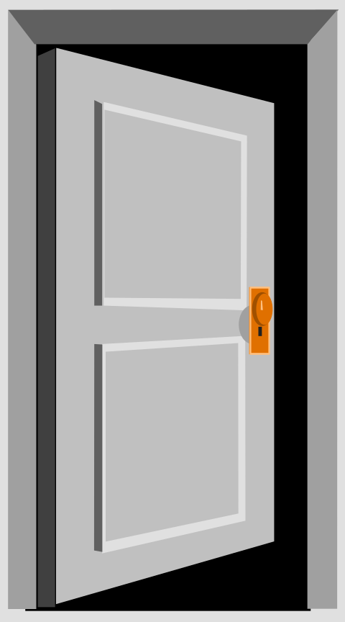
What is Vulnerability
Vulnerability is weakness associated with assets
The weakness may be exploited by threats causing loss / damage / harm to the assets
A vulnerability in itself does not cause harm until exploited

Slide 25
Vulnerabilities
Insufficient security training
Lack of security awareness
Inadequate recruitment procedures
Insufficient preventive maintenance
Lack of identification and authentication mechanisms
Transfer of passwords in clear
Unprotected public network connections
Poor password management

Slide 26
Vulnerabilities
Well-known flaws in the software
Unsupervised work by outside staff
Lack of security policies
Unprotected communication lines
Poor cable joint
Inadequate network management
Lack of audit-trail
Wrong allocation of access rights
Lack of documentation
Dial-up lines

Slide 27
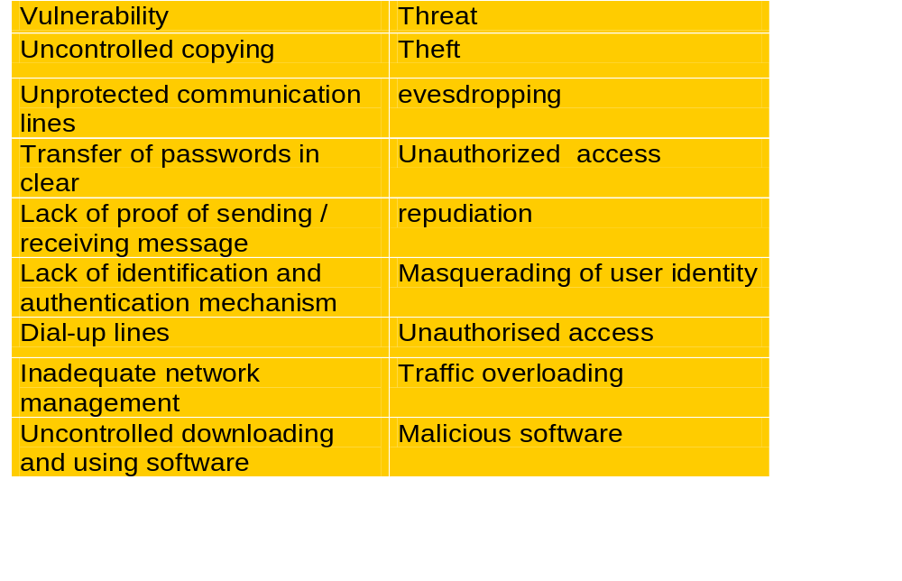
Threats & Vulnerabilities:
Network Management

Slide 28
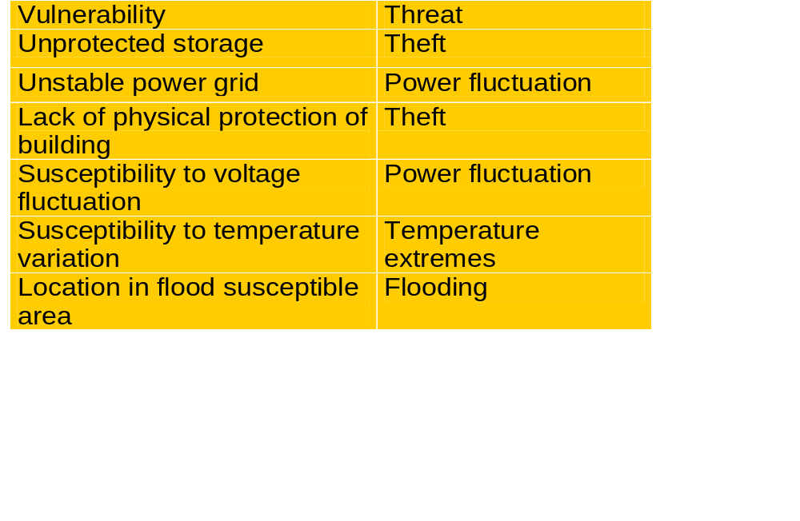
Threats & Vulnerabilities:Physical Security

Slide 29
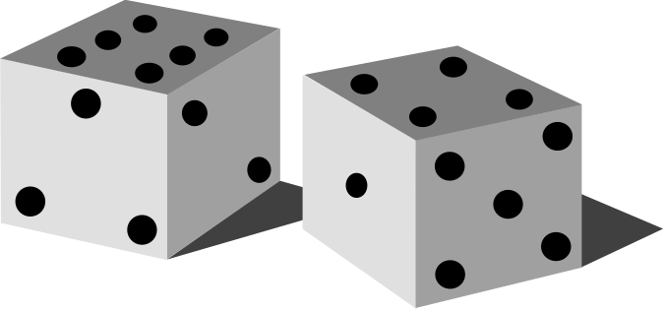
What is security risk
A security risk is the potential that a given threat will exploit vulnerabilities to cause loss/damage to asset and hence directly/indirectly to the organization
It is a function of the impact of the undesirable event and the likelihood of the event occurring.

Slide 30
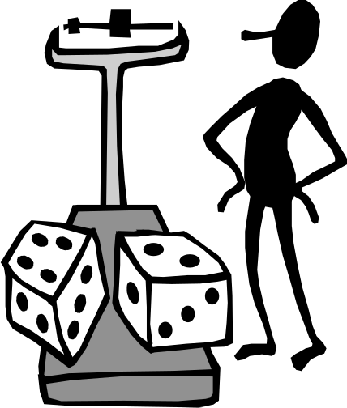
What is risk assessment
The process of identifying security risks, and determining their magnitude (this is also sometimes referred to risk analysis)
It produces an estimate of the risk to an asset at a given point in time. It answers the following questions
  What can go wrong
  How bad could it be
  How likely is it to occur
  How to manage the risk

Slide 31
Risk assessment Process
Asset identification and valuation
Vulnerability assessment
Threat assessment
Identification of existing and planned security controls
Risk assessment

Slide 32
Risk Management Process
Identification and selection of security controls
Risk Assessment Output
Reducing the risk
Risk Acceptance
Risk Management Process

Slide 33

What is Security Control
A practice procedure or mechanism that reduces security risks

Slide 34
Security Controls
Defined and documented security policy
Management framework to initiate and control implementation of security
Allocation of security responsibilities
Third party access control through suitable clauses in the contract
Accountability of assets through a inventory list and nominated owner for each asset
Suitable confidentiality and other security agreements with staffs

Slide 35
Security Controls
Security education and training to staffs
Reporting security incidents, weaknesses, malfunctions
Suitable disciplinary process in case of security breaches by staffs
Restrict physical access to the server and other vital information processing facilities
Physically protect equipment, power and communication cables from security threats and environmental hazards

Slide 36
Security Controls
Proper preventive and corrective maintenance of information processing facilities
Secure disposal of equipment
Clear desk and clear screen policy
Documented operating procedures
Controlled changes to information processing facilities and systems
Capacity planning by monitoring and anticipating future requirement of processing power and storage space

Slide 37
Security Controls
Protection against malicious software through user awareness and suitable anti-virus mechanism
Regular backup of essential business information and software
Proper implementation of required network controls through OS features and other tools
  Network monitors eg IDS
  Encryption of transmitted data
  Internal user access control
  External access control eg firewall

Slide 38
Security Controls
Secure storage, handling and disposal of removable media
Suitable e-mail policy and relevant controls
User access control policy and management
Network access control policy and management
Monitoring system access and use
Mobile computing and tele-working policy and management
Cryptographic controls-encryption, digital signature, non-repudiation services, key management

Slide 39
Security Controls
Controlled access to the system files and program source library
Suitable tested and qualified business continuity plan
Compliance with legal and contractual requirement e.g. IPR, DPA etc..
Review of security policy and technical compliance
Regular audits of operational systems

Slide 40
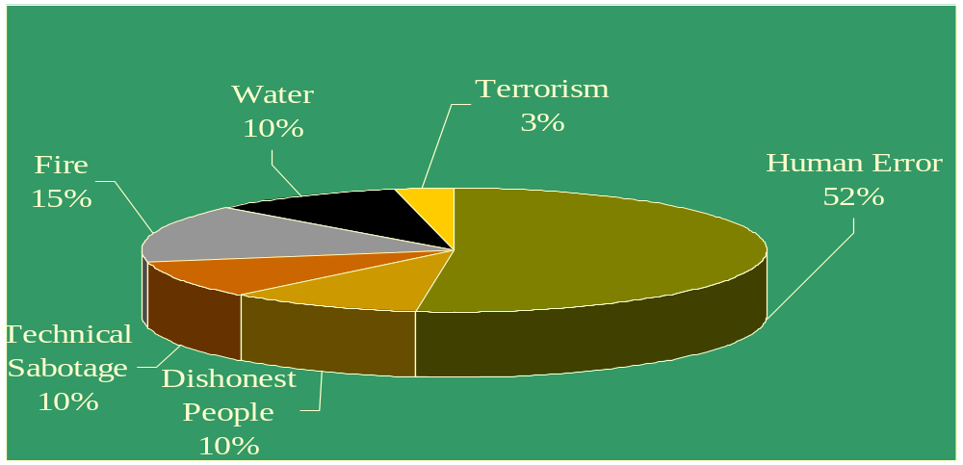
IT Security: Global Trends...
Common Causes of Damage

Slide 41
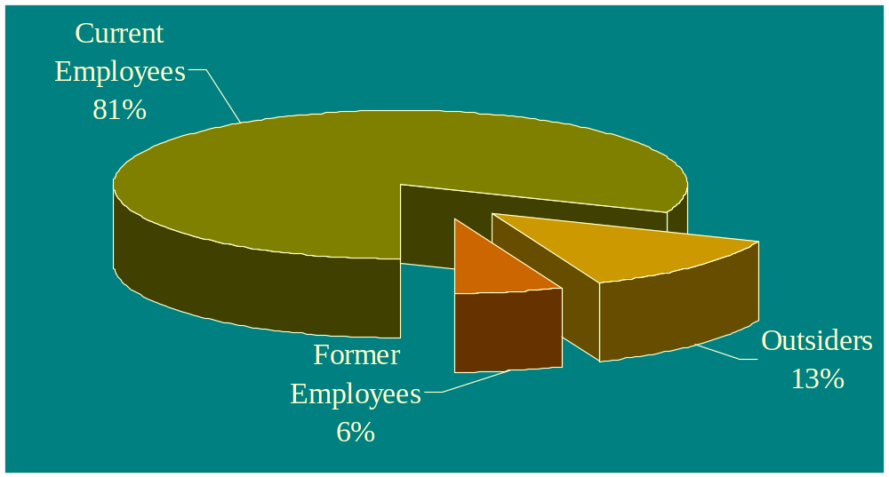
IT Security: Global Trends...
Who causes Damage?

Slide 42
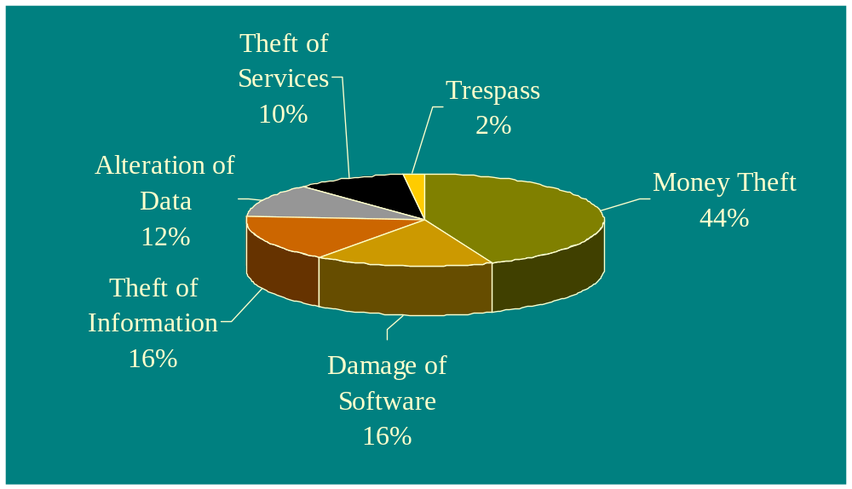
IT Security: Global Trends
Types of Computer Crime

Slide 43
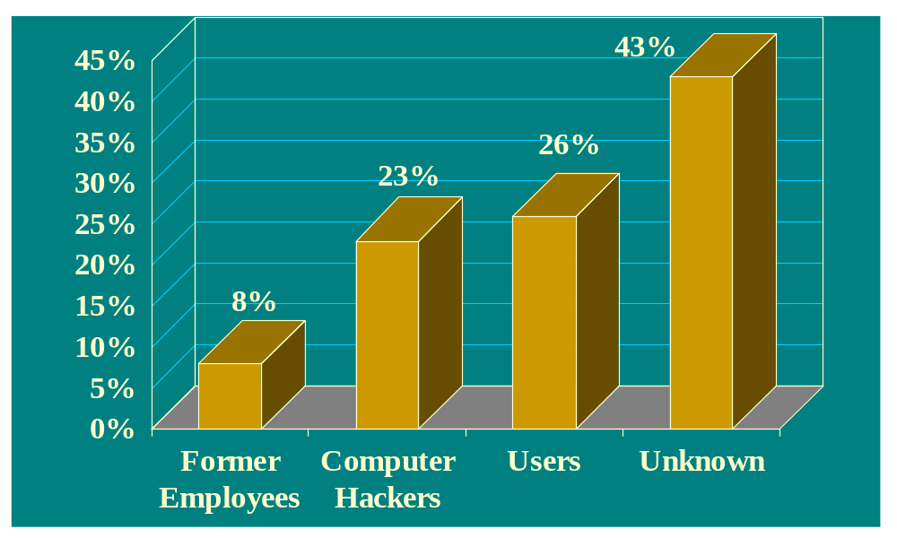
Security Breaches
IT Security: Indian Trends...

Slide 44
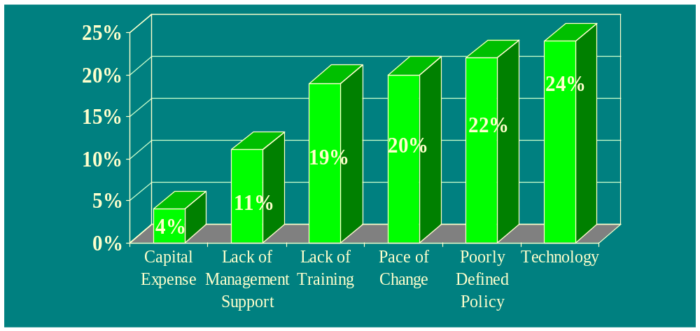
Obstacles in Information Systems
IT Security: Indian Trends...

Slide 45
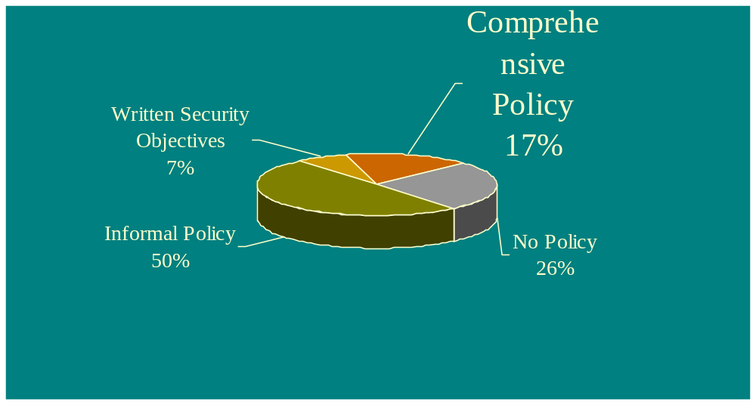
IT Security: Indian Trends...
Various Types of Security Policies

Slide 46
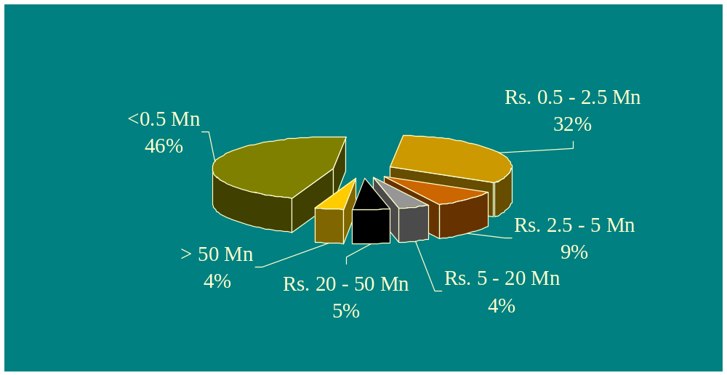
IT Security: Indian Trends...
Proportion of Information Security Budget

Slide 47
Sources of Information
CERT (www.cert.org)
  CERT Advisories, Incident Notes, Vulnerability Notes …
SANS (www.sans.org)
CIAC (www.ciac.llnl.gov/ciac)
AUSCERT (www.auscert.org.au)
SURFNET (http://cert.surfnet.nl/home-eng.html)
NIST (http://icat.nist.gov/icat.taf)
FIRST (www.first.org)

Slide 48
Thank You

